Slide 1

Grammar & Basics
Prepositions

Slide 2
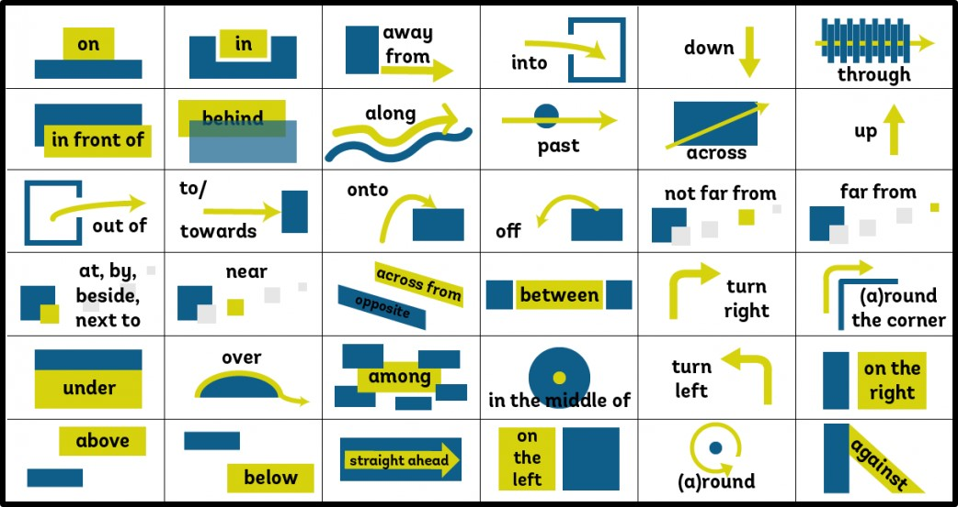

Slide 3
Prepositions
Are used to express:
Time: in, on, at, after, before etc.
Position: in, on, at, behind, in front of etc.
Movement: into, out of, off, across, from etc.
Other relations: by, about etc.

Slide 4
Prepositions
Can be confusing for Dutch learners as they are not always the same in translation
He is in the garden → hij is in de tuin
He will be there in 5 minutes → hij is er over 5 minuten
Study the lists in the book and look for parallels
If it’s in September, it’s also in October
If it’s at lunch, it’s also at dinner
Other ways to learn them
Dictionary
Read a lot
Learn often used phrases by heart

Slide 5

Confusing cases – I
Some prepositions that look alike or translate to the same Dutch word are discussed on the following slides
After that some common mistakes based on ‘false friends’
(= words that look alike in two different languages but don’t mean the same) are discussed

Slide 6
Confusing cases - II
During or for?
For = how long
He worked here for 2 months.
During = when
We met some nice people during our holiday.
Compare:
I fell asleep during the movie. I slept for half an hour.
Note: while is not a preposition, but a linking word, so it’s followed by a clause/sentence (with subject and verb)
We met some nice people while we were on holiday.

Slide 7

Confusing cases - III
In or into?
In = position
I’m in the bathroom.
Into = movement
He walked into the bathroom.
The opposite of into is out of
I told him to get out of the bathroom.

Slide 8
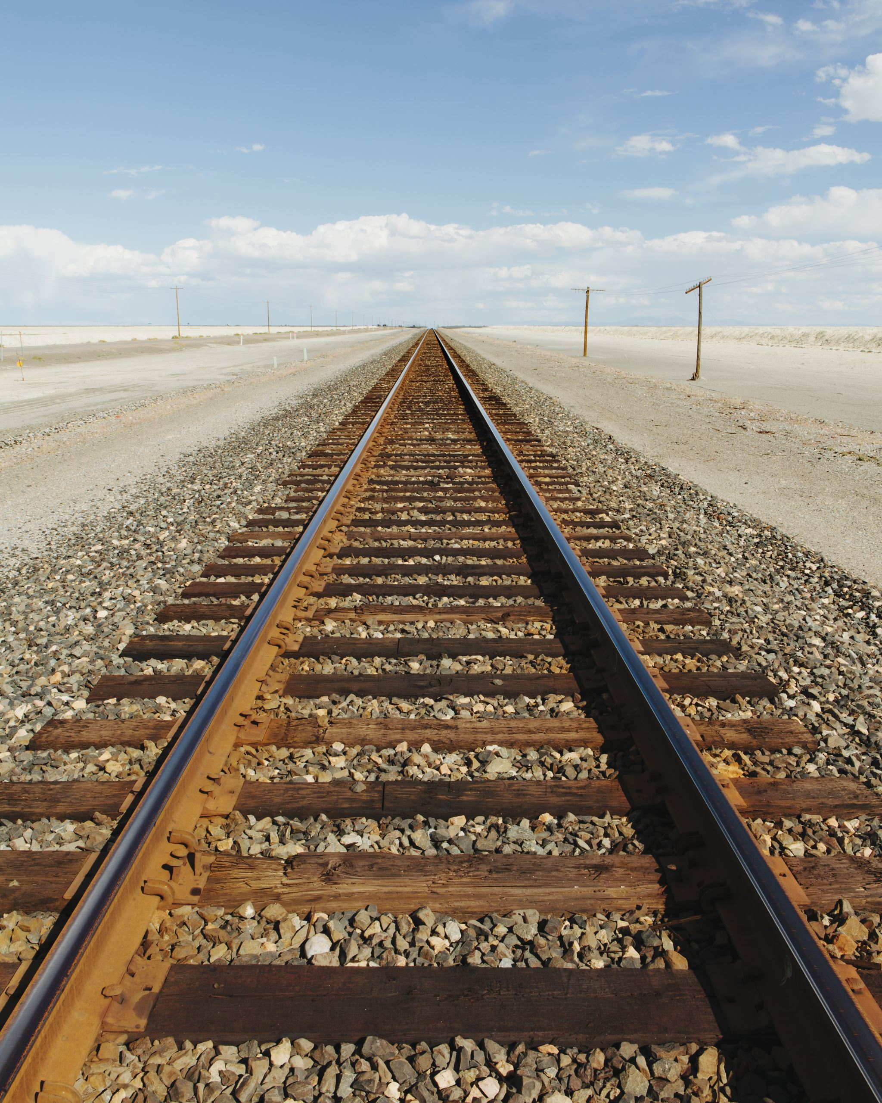
Confusing cases - IV
To or till?
To = movement
We drove to Paris, but then we had to take a rest.
Till = time
My wife drove till 7.00, and then I took over.
Note: ‘too’ with two o’s is not a prepostion, and can mean:
‘also’: I saw him too.
Dutch ‘te’: He drank too much.

Slide 9
Confusing cases - V
Off or of?
Off is the opposite of on
He switched the computer off and on again.
The book was on the table, but then it fell off.
Of is used in all other cases (usually translates to Dutch ‘van’)
He is the head of our department
She cried tears of happiness.

Slide 10
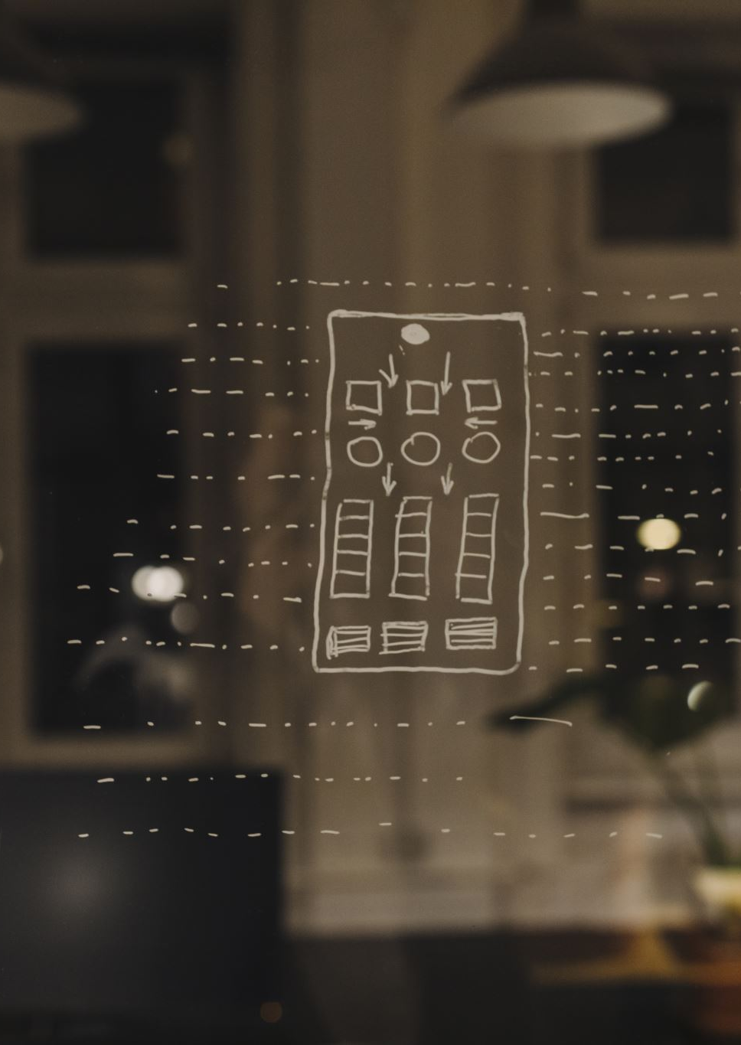
Confusing cases - VI
Before, in front of or for?
Before = time
Shall we meet before 7:00?
In front of = position
Ok, I’ll be waiting in front of the restaurant.
For = other
I will bring something special for you.

Slide 11
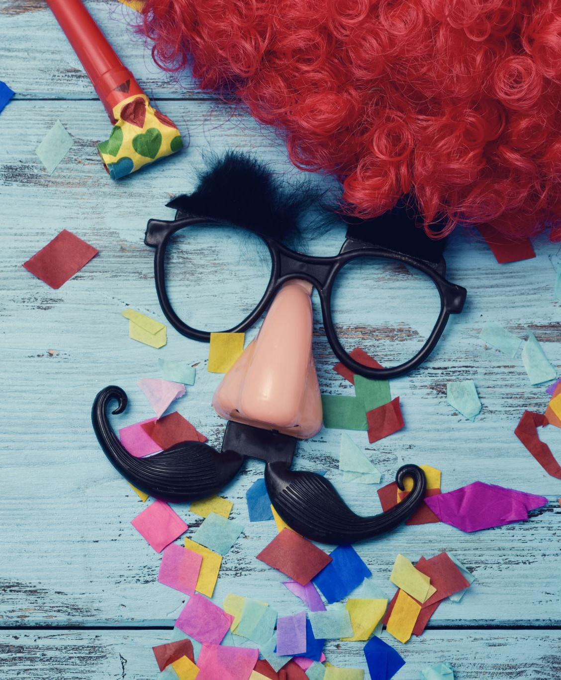


Confusing cases - VII
As or like?
As refers to a job or function
He works as a clown at children’s parties.
Like is used to talk about things being similar
He acted like a clown in class today.

Slide 12
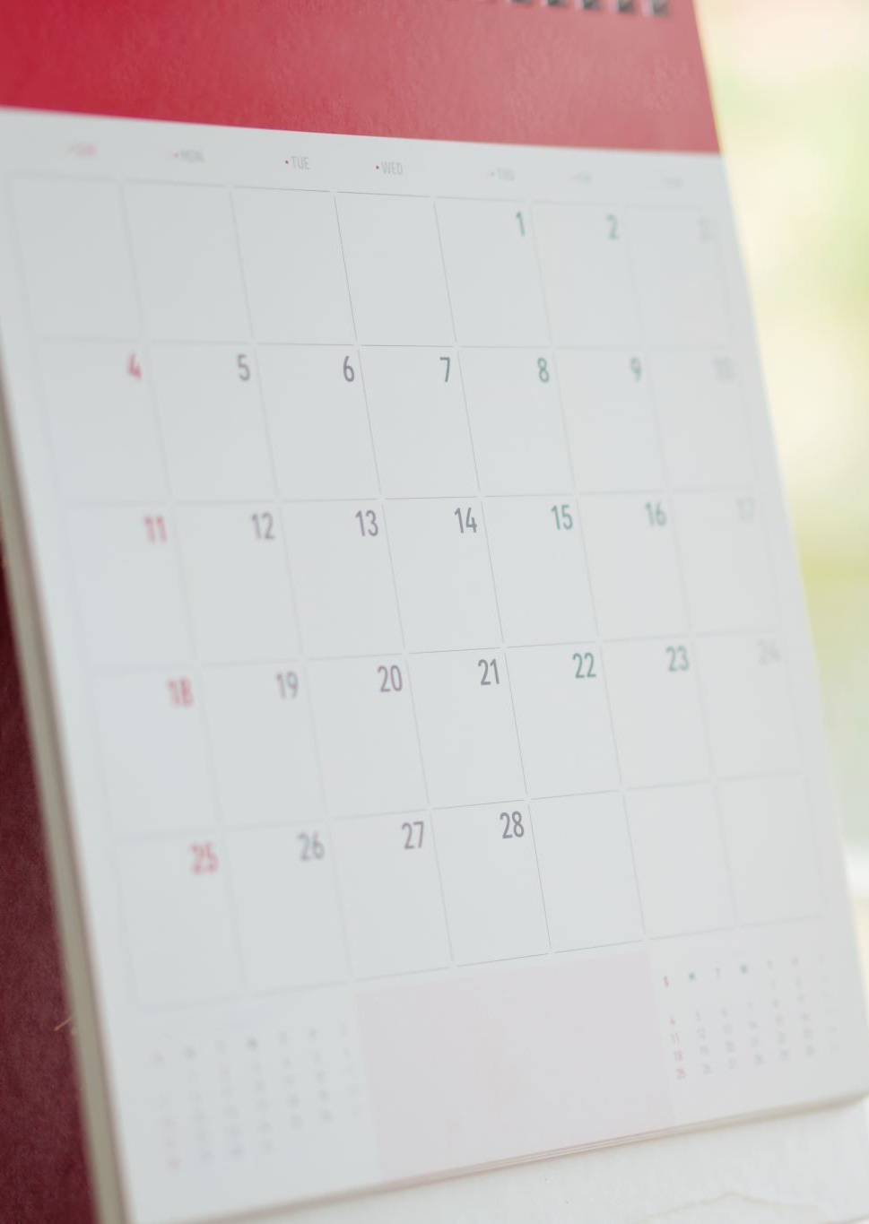
Confusing cases - VIII
In time or on time?
In time means ‘early enough’
I was in time for the announcement of the winner.
On time means ‘at the right time’ or ‘on schedule’
The show started right on time.

Slide 13
Common mistakes by Dutch people - I
Ik ben niet goed in Engels
I’m not good in English
I’m not good at English
Ik zit nog op school
I’m still on school
I’m still at school OR I’m still in school
Ik zat achter de computer
I was sitting behind the computer.
I was sitting at the computer

Slide 14
Common mistakes by Dutch people - II
Ik ga met de trein naar school
I go to school with the train.
I go to school by train.
Hij werkt hier sinds twee maanden.
He has worked here since two months
He has worked here for two months
Ik ben bij de bakker.
I am by the baker’s.
I am at the baker’s.

Slide 15
Exercise: Using the right preposition: identify if the prepositions are correct or wrong. If wrong, correct them.
She is engaged with David
She entered into the room.
He is intelligent, but he lacks of experience.
Except coats or sweaters, you are not allowed to wear outer clothing.
On October, we went for a skiing vacation in Switzerland
Every summer I fly to Brazil and sit in the beach.
He decided to protest over the depiction of violence towards animals.
He told to me that he liked it.
Jane was in the wedding.

Slide 16
Using the right preposition: the answers
She is engaged to David
She entered the room.
He is intelligent, but he lacks experience.
Except for coats or sweaters, you are not allowed to wear outer clothing.
In October, we went for a skiing vacation in Switzerland
Every summer I fly to Brazil and sit on/at the beach.
He decided to protest against the depiction of violence towards animals.
He told me that he liked it.
Jane was at the wedding.

